Slide 1
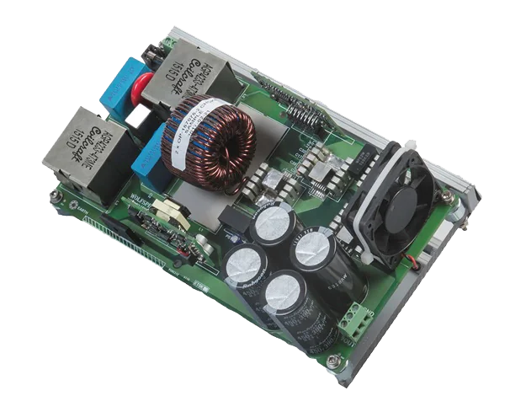
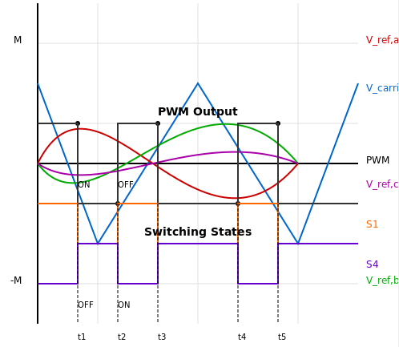
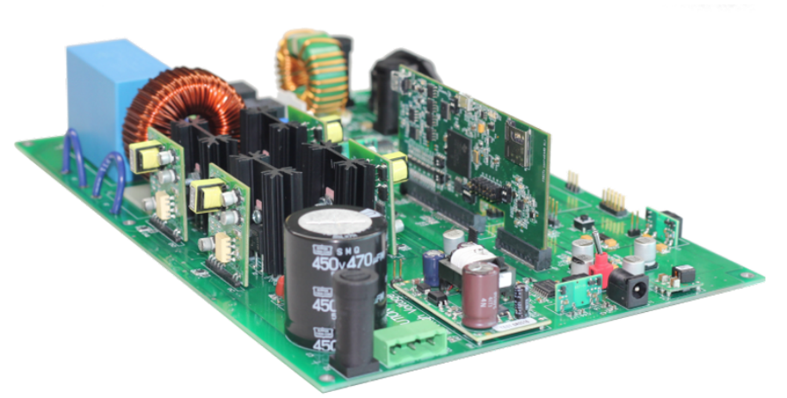
William Santos/Rosana Mendes
Design Concept - Overview
110V AC Single-Phase to 220V AC Three-Phase 1KW

Slide 2
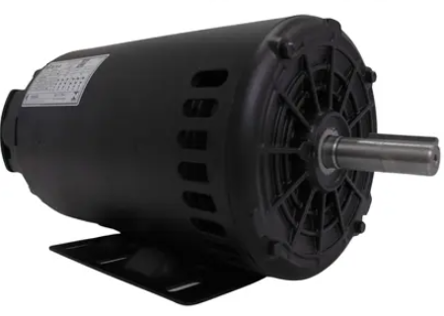
William Santos/Rosana Mendes
Design Concept - Overview
RECTIFIER
CONTROLLER
INVERTER
Three-Phase
SINGLE-PHASE
PWM CONTROL
INPUT 127 AC
AC/DC
DC/AC
DC
127AC 180DC
310VC 220AC
Electric Motor
AC 220V
180VC
BOOST CONVERTER
310VC

Slide 3
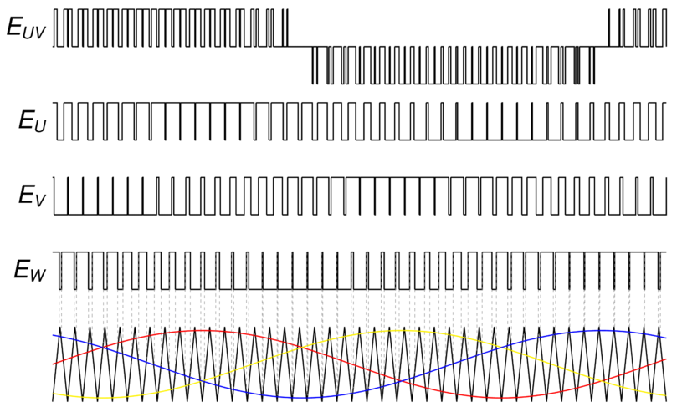


William Santos/Rosana Mendes
Design Concept - Overview
RECTIFIER
WHY IS IT NECESSARY TO RECTIFY A SIGNAL FROM AC TO DC?
SINGLE-PHASE
PWM CONTROL TO BUILD THE THREE PHASE
INPUT 127 AC
AC/DC
127AC 180DC
VDC = VRMS*$\sqrt{2}$
VDC = 127*$\sqrt{2}$
VDC = 179.6051 V
VDC =~ 180V

Slide 4
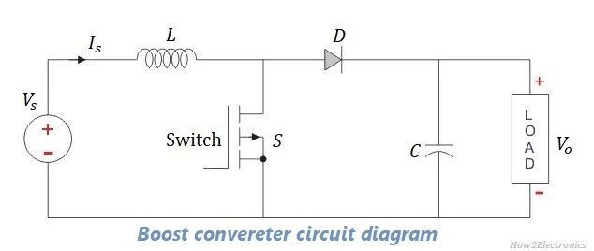

William Santos/Rosana Mendes
Design Concept - Overview
CONTROLLER
WHY IS IT NECESSARY TO BOOST A SINGAL FROM 180V DC TO 310V DC?
PWM CONTROL
Electric Motor Requires 220V AC RMS to Run
DC
VDC = 220*$\sqrt{2}$
VDC = 311.12 V
180VC
BOOST CONVERTER
310VC
VDC =~ 310 V
BOOST CONVERTER
180VC
310VC

Slide 5
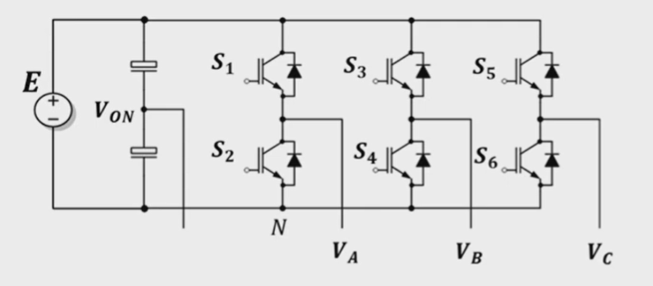
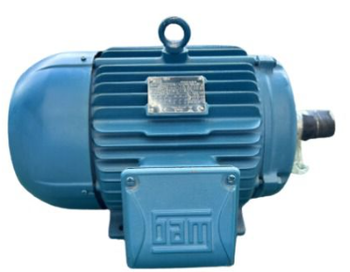
William Santos/Rosana Mendes
Design Concept - Overview
INVERTER
Three Phase Inverter
Three-Phase
DC/AC
310VC 220AC
Electric Motor
AC 220V
220V
220V

